Slide 1

Ethics & Communication Project
Stuart McColl

Slide 2

Should there be a mandatory code of conduct for all data scientists?

Slide 3
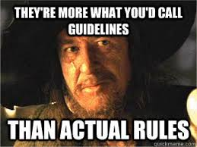
As it stands...
...there is currently no requirement for data scientists to hold any specific qualification or industry membership.
Codes of conduct within
the data industry
are voluntary.
Yes, I stole this meme from the class notes!

Slide 4

Challenges
The two biggest challenges for implementing a mandatory code of conduct would be:
1. The data industry is huge.
2. The data industry is diverse.

Slide 5
Solution?
Profession | Institution | Acronym
Surveying | Royal Institution of Chartered Surveyors | RICS
Accounting | Institute of Chartered Accountants of Scotland | ICAS
Architecture | Royal Institute of British Architects | RIBA
One possible solution would be to learn from other industries and to incorporate the membership into an institution as part of the journey to becoming a data scientist.

Slide 6

Membership
Membership could be similar to that of the RICS.
In order to become a member, you must complete an Assessment of Professional Competence (APC).

Slide 7
Benefits of an Institution
Institutions, such as the RICS, uphold professional standards across all disciplines within the commercial property sector and set the rules of conduct for areas including:
Professional Competence
Ethical Conduct
Consumer Protection

Slide 8

Where would we start?
One place to start would be the Insitute of Analytics (IOA) and to grow its membership. Currently they have 4,500 members worldwide.
Another place to start would be the Code of Conduct for Professional Data Scientists. This code of conduct is a joint initiative between Oxford University and the University of Granada.

Slide 9
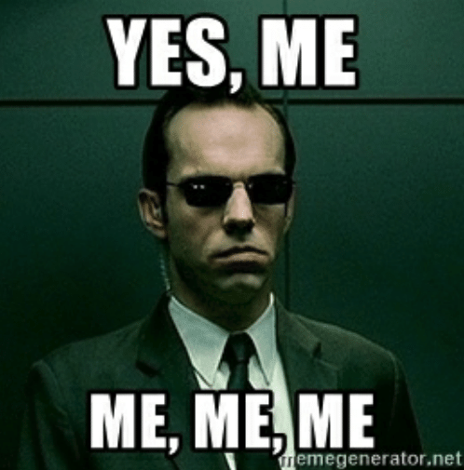
My recommendation?
In my personal opinion, I believe it would be a good idea to have a mandatory code of conduct for all data scientists.
I also believe that joining an institution should very much be part of the journey into data science as they can uphold the code of conduct.
If there was no RICS for the commercial property industry, there would almost certainly be more corruption, bribery, money laundering and conflicts in interest and not to mention the ethical challenges that it would face.
I also believe that it would promote greater transparency within the data profession and allow for consistency and a clear set of guidelines for everyone follow.

